Slide 1
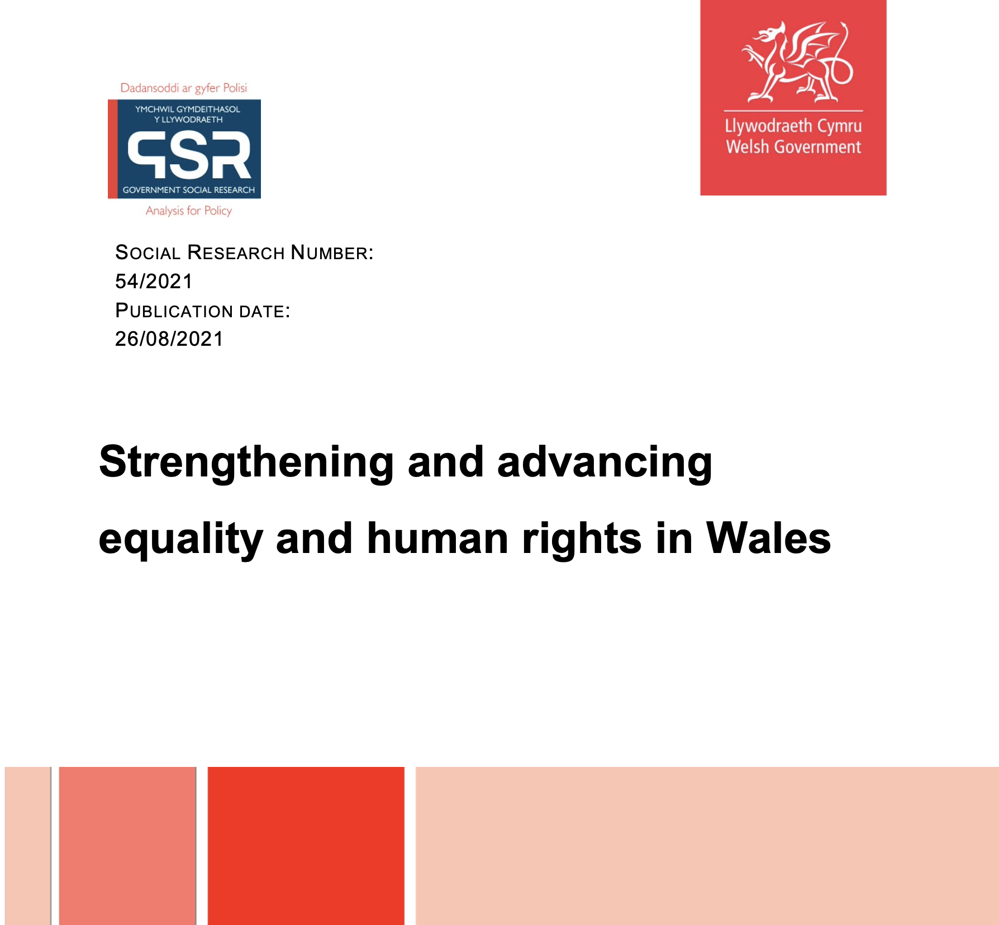


Human Rights Present and Future for Wales
Strengthening and advancing equality and human rights
This Photo by Unknown Author is licensed under CC BY-NC

Slide 2
Human rights present:
Government of Wales Act 2006:
Senedd competent to observe and implement UK’s international obligations (sch.7A)
Welsh Ministers power to promote economic, social, environmental well-being (s.60) (powers include introducing Bills)
Legislative framework
Rights of Children and Young Persons (Wales) Measure 2011 (UNCRC)
Social Services and Well-being (Wales) Act 2014 (UNCRC & UNPOP)
Additional Learning Needs and Education Tribunal (Wales) Act 2018 (UNCRPD and UNCRC)
Additional commitments:
Action on Disability: A Framework for Independent Living (UNCRPD)
Children's Rights Impact Assessment
Race Equality Action Plan (CERD)
Wales, a Nation of Sanctuary
Incorporate CEDAW – programme for government
Incorporate UNCRPD – programme for government

Slide 3
Human rights future
Limitations of Welsh devolution:
Reserved areas
Taxation
Control over welfare benefits
Control over justice system
Fused judicial system
Human rights regression:
“We are disappointed by the pejorative and leading nature of the report and the consultation questions. It remains our firm view that human rights are, and should continue to be, irreducible and apply equally to all persons.”
“… many key proposals are not supported by evidence, or use evidence unfairly or inappropriately, relying on extreme cases to justify change and misrepresenting how UK courts have overwhelmingly acted proportionately and responsibly in applying international human right laws with full respect for the laws of the UK.”
Welsh Government response to UK Government proposals to repeal HRA 1998

Slide 4

40 Recommendations
Legislation and leadership
Involving people with an interest
Guidance
Impact assessment
Process alignment
Monitoring
Accountability and enforcement
Raising awareness
Covid-19

Slide 5
Recommendations 1 and 25: The legal framework and accountability
Recommendations
1. The Welsh Government should introduce primary legislation to give effect to international human rights in Welsh law through a Human Rights (Wales) Act to make select international human rights part of Welsh law so that they are binding on Welsh Ministers and public authorities in the exercise of devolved functions and may be enforced by a court or tribunal.
25. The Welsh Government should introduce primary legislation to enable individuals to bring an action before a court or tribunal to enforce their (incorporated) human rights.

Slide 6




Human rights incorporation
Clear support for further human rights incorporation in Wales .
Retain aspects of ‘due regard’ to support mainstreaming human rights policy development but is perceived as weak when it comes to legal accountability
Move toward direct incorporation

Slide 7
Progress:
Report published August 2021
Welsh Government response May 2022: number of workstreams (Strengthening and Advancing Equality and Human Rights in Wales research report: Welsh Government response | GOV.WALES)
Welsh Government Human Rights Advisory Group to support workstreams (July 2022)
Legislative Options Working Group to progress recommendations 1 and 25 (September 2022)
LOWG engaging with key to examine modes of incorporation and rights to be incorporated
Research recommended legislation before end of current Senedd (May 2026) but LOWG will take as long as required

