Slide 1

Incorporation of the UNCRPD in the NI context
Lessons from Devolution
Nuala Toman
Disability Action

Slide 2

Current context
Non progression of the Bill of Rights
Political support for the Bill of Rights
Public support
Erosion of Human Rights
Non compliance
Political Crisis
Cessation of funding for human rights work
No funding identified for NDNA commitments
Prolonged political and public finance crisis
Cross Party Support for the Incorporation of the UNCRPD into law
……….But- what is the mechanism for incorporation

Slide 3
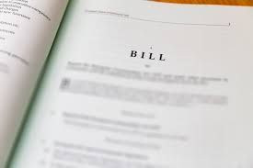
Option 1 PMB
MLA led
Involves a consultation process
Potential for Departmental pick up
But
Push back from Bills of Office due to fall out from the Integrated Education Act (2022)
Challenges re parliamentary time

Slide 4

Option 2: Departmental Legislation
Dependent on Minister
Relevant to the development of the Disability Strategy

Slide 5

Lessons from Scotland
Delivery plan for the UNCRPD with five ambitions
support services that meet people's needs and promote independent living
decent incomes and fairer working lives
places that are accessible to everyone
protected rights
active participation
The plan includes legislative commitments

Slide 6

Impact and approach
Incorporation would ensure that the provisions of the UNCRPD form part of domestic law
Human rights become enforceable
Institutions and procedures are available to provide a remedy to human rights violations
Stronger implementation- law, policy and measures
Preferred model is direct incorporation

Slide 7

Contact details
nualatoman@disabilityaction.org

