Slide 1
Legal approaches and lessons on incorporation from Scotland
Nicole Busby
University of Glasgow

Slide 2
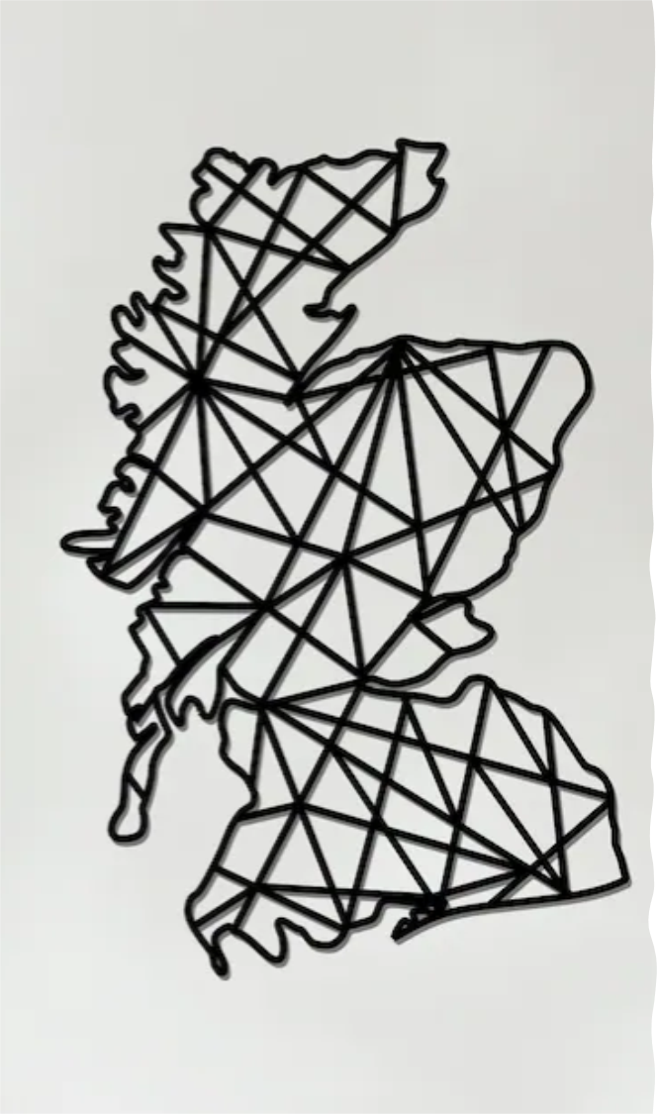
The Scottish context
Devolution provides a foundation and vehicle for human rights progression – see civil and political rights under the HRA/SA 1998
Current developments in Scotland are aimed at providing a means of advancing economic, social, cultural and environmental rights by way of the incorporation of international human rights treaties into Scots law
Opportunities
Separate legal system
Devolved policy areas (housing, education, health)
Threats
Interrelationship between laws and policies potentially affected by human rights incorporation (equality, employment, immigration)
Threats to human rights progress at UK level = threats to Scotland’s plans

Slide 3
Scottish devolution and human rights
The Scotland Act 1998 provides that the Scottish Parliament cannot legislate in a way that is incompatible with the ECHR (s. 29, SA 1998)
Legislation must be read in so far as is possible to ensure compliance with the ECHR (s. 101, SA)
The Scottish Government (s. 57) and all public bodies including the courts (s. 6) must act compatibly with the ECHR
The Human Rights Act 1998 and the Equality Act 2010 are ‘protected enactments’ placing them beyond the power of the Scottish Parliament to amend (Schedule 4).
Devolution thus creates a constitutional framework for the ECHR as a minimum level of human rights protection that the devolved legislatures, governments and courts must uphold.

Slide 4
Scotland’s incorporation agenda
Bill to incorporate – ICESCR, CERD, CEDAW and CRPD into Scots law
Parallel process for CRC
Reference by the Attorney General and the Advocate General for Scotland – UN Convention on the Rights of the Child (Incorporation) (Scotland) Bill [2021] UKSC 42
*Likely* approach:
ICESCR – due regard leading to full compliance
CERD, CEDAW, CRPD – positive duties (due regard) imposed on Scottish public authorities
Can this make a difference in Scotland?

Slide 5
Lessons on incorporation from Scotland
Political will is crucial
Positive public conceptions of human rights matter
Collaboration is key
civil society and political institutions need to work together wherever possible
solidarity between civil society actors, academics, devolved nations
Need to ensure the capacity to deliver – local authorities, public institutions (NHS), courts and tribunals, etc.
Westminster continues to exert control over Scotland, even in devolved policy areas

